Slide 1

TRƯỜNG CAO ĐẲNG LÝ TỰ TRỌNG TP.HCM
BẬC ĐÀO TẠO: CAO ĐẲNG CHUYÊN NGHIỆP
GIẢNG VIÊN: NGUYỄN THỊ THU TÂM

Slide 2
UNIT 2
BÀI : STARTER

Slide 3

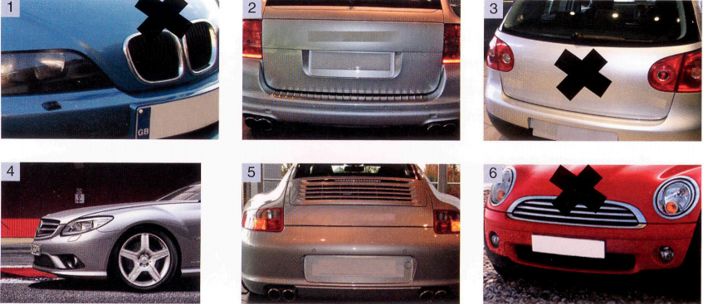
UNIT 2: THE EXTERIOR

Slide 4
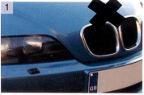


1926- MUNICH

Slide 5
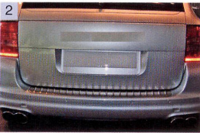


Vauxhall
1903-

Slide 6
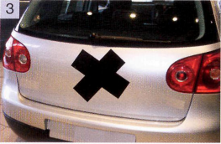


VW
VW
1937

Slide 7
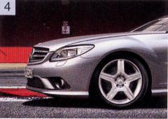





Slide 8
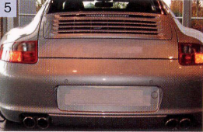

Ferdinand Porsche
1931
Germany

Slide 9
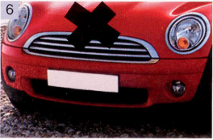

1959 - England

Slide 10

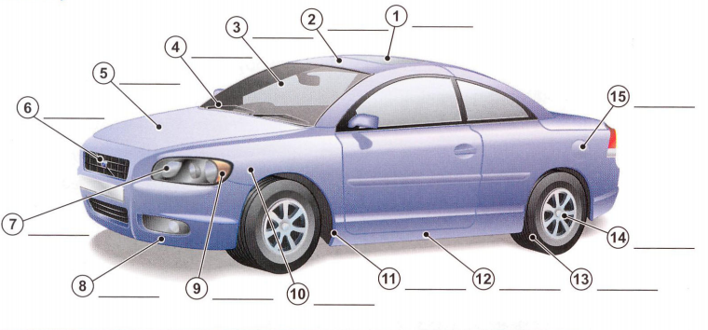
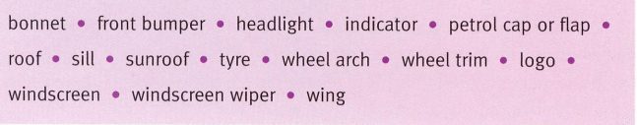
4.windscreen
wiper
roof
sunroof
petrol
flap
bonnet
windscreen
logo
wing
wheel
trim
headlight
sill
front bumper
tyre
indicator
wheel arch

Slide 11
1. sunroof
1. sunroof
2. roof
3. windscreen
4. windscreen wiper
5. bonnet
6. logo
7. head light

Slide 12
8. front bumper
9. indicator
10. wing
11. wheel arch
12. Sill
13. tyre
14. wheel trim
15. petrol flap

Slide 13
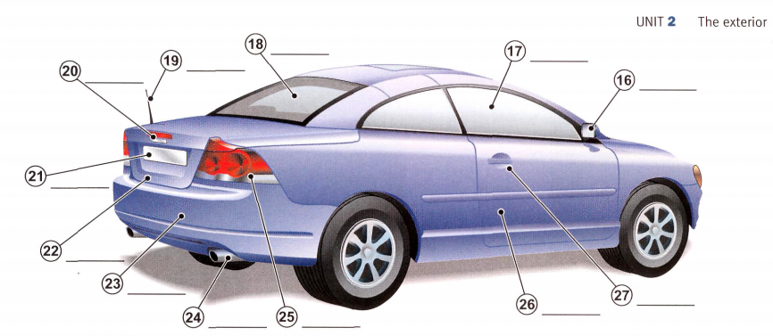
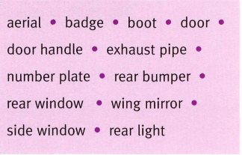
rear
window
side
window
badge
wing
mirror
aerial
number
plate
rear
light
boot
rear bumper
door
handle
exhaust pipe
door

Slide 14
16. wing mirror
22. boot
17. side widow
23. rear bumper
18. rear window
24. exhaust pipe
25. rear light
19. aerial
20. badge
26. door
21. number plate
27. door handle

Slide 15
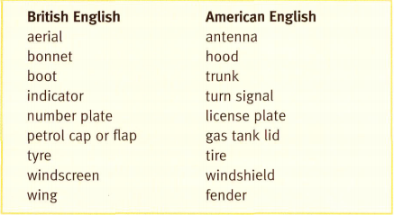

Slide 16

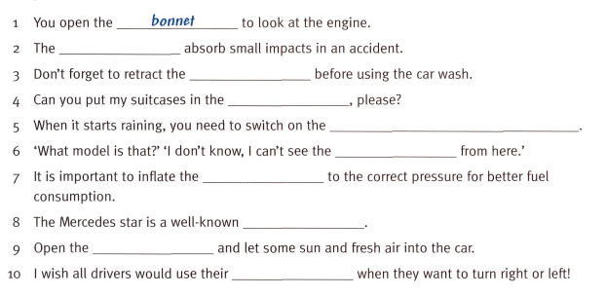
bumpers
aerial
boot
windscreen wiper
badge/logo
tyre
logo
sunroof
indicator

